Slide 1

Extending Podman Desktop
Red Hat

Slide 2
What we’ll discuss today
Agenda
Podman Desktop Overview
Architectural Overview
Extending Podman Desktop

Slide 3
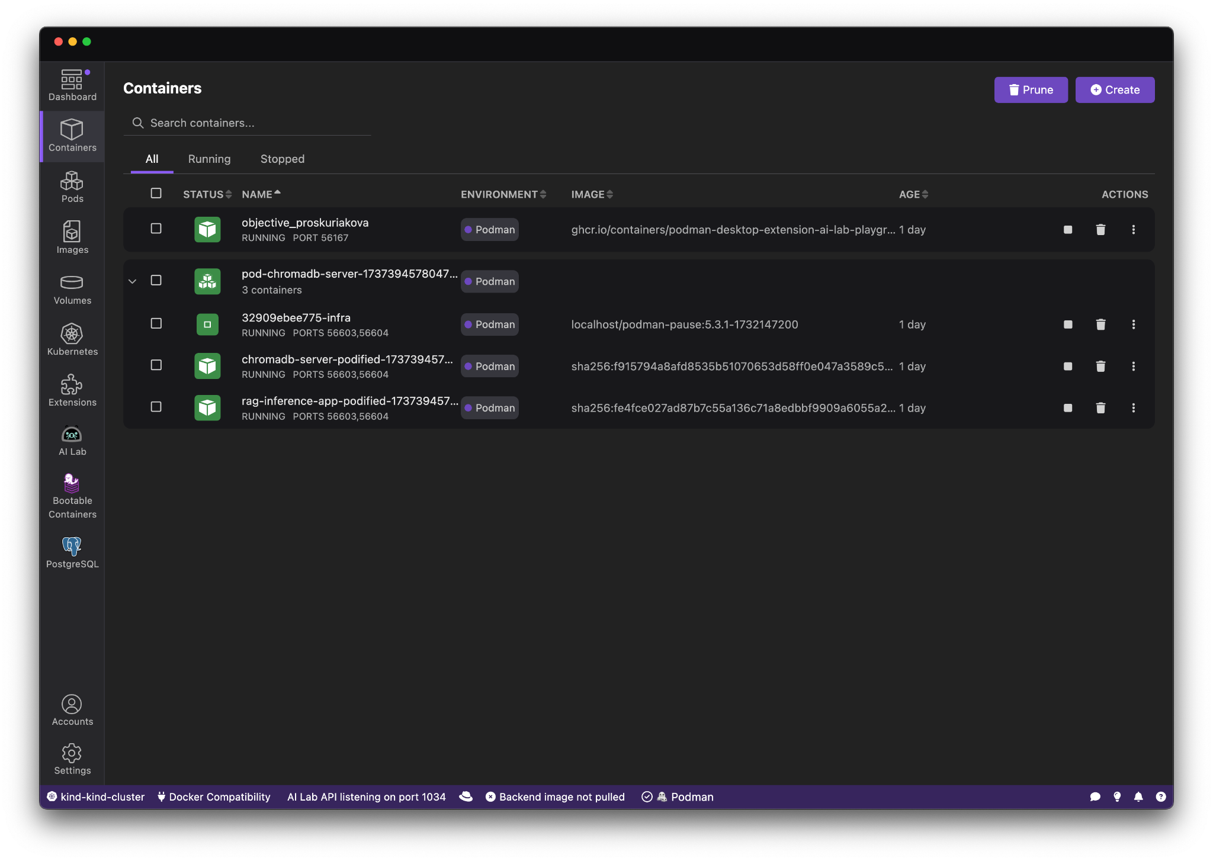
What is Podman Desktop?
Podman Desktop provides an intuitive and user-friendly interface for developers to easily work with Containers and Kubernetes. It simplifies container management, streamlines Kubernetes workflows, and transitions from local development to production.
Podman and Kubernetes
Install and run anywhere: Windows, Mac and Linux
Keep it up-to-date
Containers and Pods
Build, run, manage and debug Containers and Pods
Run Pods with or without Kubernetes
Manage multiple container Engines
Compatibility with Docker and Compose
Enterprise Readiness
VPN and Proxies configuration
Image registry management
AirGapped Installation
Bridge between local and remote
Connect and deploy to remote Kubernetes clusters
Enable remote managed services locally

Slide 4
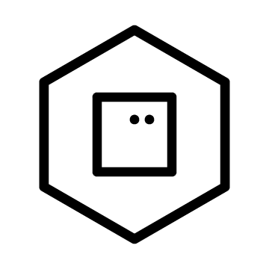
Mission Statement
Provides an simple onboarding for the application developers to go from applications to containers, to pods, to Kubernetes.
Kubernetes Cluster
Docker-Compose
Ingress/Router
Pod
Pod
Pod
Container
Pod
Node
Node
Node
KInd / Minikube
Podman Engine
Kubernetes Remote and Managed Services

Slide 5
Architectural Overview

Slide 6
Technical Overview
Built using Svelte, Tailwind, and Electron
Very extendable: container engines, Kubernetes providers, CLI tools, menus, Webviews, Docker Desktop extensions, …
Renderer (UI)
Frontend(UI)
Simple package
main
UI Library
Backend
Extension API
Simple Extension
Extension with Webview
Podman Desktop

Slide 7

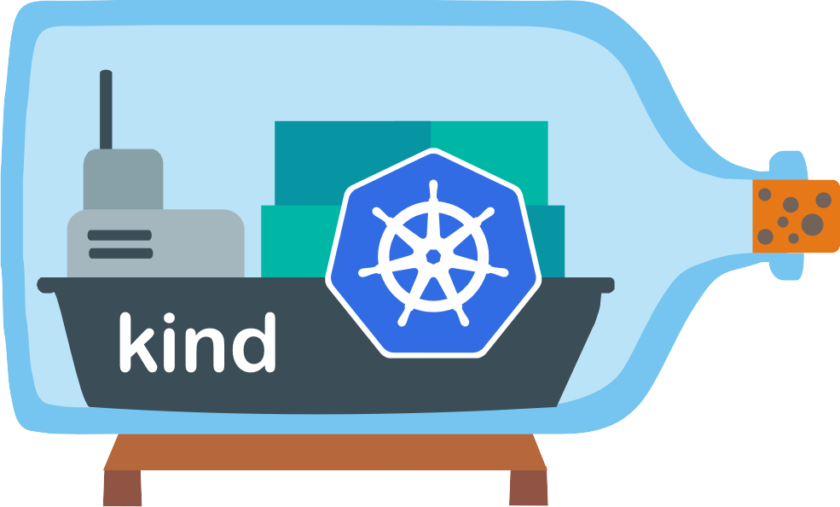
Architecture Overview
Podman
Kind
socket
cli
Podman Extension
Kind Extension
Container Provider extension point
CLI Tool API
Kubernetes Provider extension point
Extension API
Podman Desktop

Slide 8
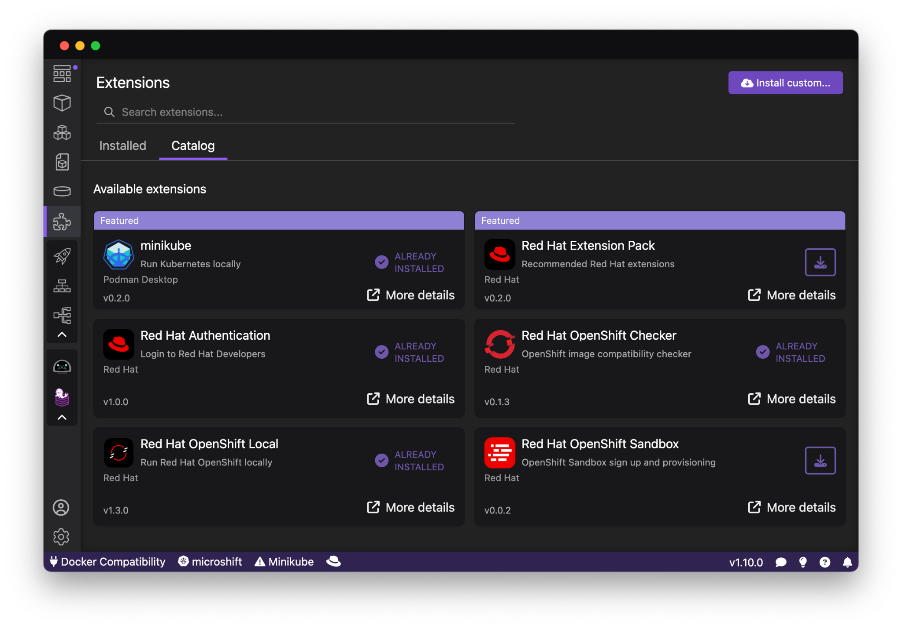




Extensibility
But Podman Desktop extensions can also do much more:
Container engine providers
Kubernetes providers
Add actions
Add menus
Add configuration
Add default registries
Add to status bar
Add to system tray
Add webviews
Supports Docker Desktop extensions
Current
extensions:
& more!
Podman
Kind
Lima
Docker
OpenShift Local

Slide 9
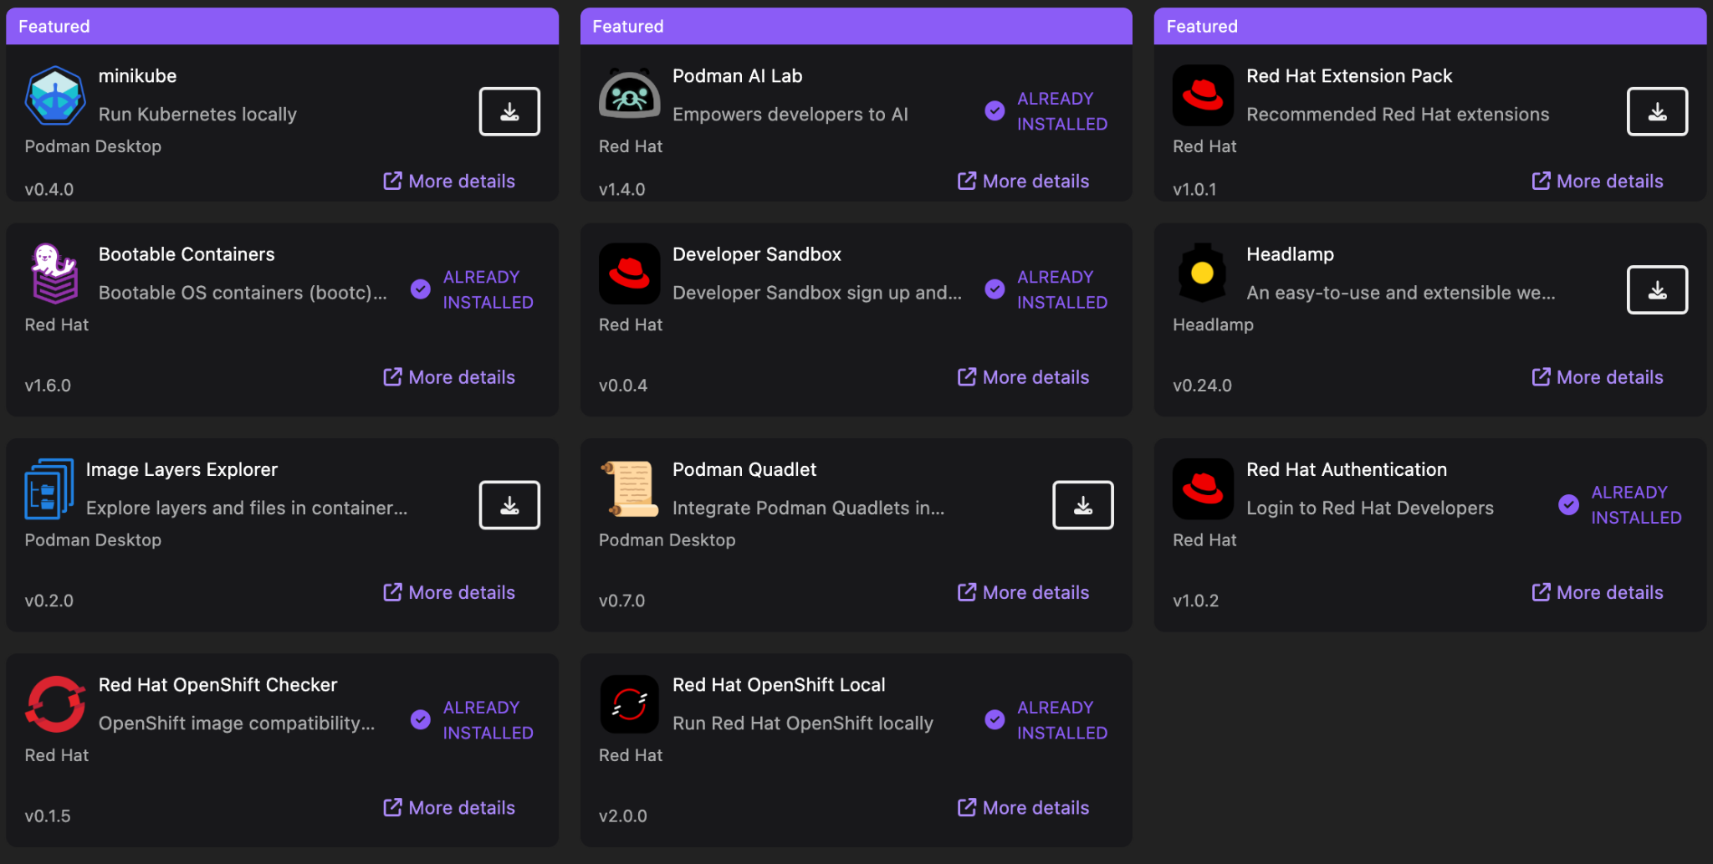
Extension Catalog
Easy to install any extensions, including Docker Desktop extensions

Slide 10
Extending Podman Desktop

Slide 11
Extensions
Building an extension is the fastest way to add function to Podman Desktop
(Although we’re always open to contributions to the core, including new extension points)
There is lots of help to get started - we’ll cover the highlights here
Main page: https://podman-desktop.io/extend
Documentation: https://podman-desktop.io/docs/extensions/developing
Tutorial on creating an extension: https://podman-desktop.io/tutorial/creating-an-extension

Slide 12
Extension Options
Extensions are distributed as OCI images from OCI registries
Two styles of extensions are supported:
Podman Desktop extension model
Fine grained - contribute to individual actions or API
Docker Desktop extension model
Coarse grained - contribute a whole page to the navigation
Are you the author of a Docker Desktop extension?
Use the ‘Install custom’ option to quickly test it in Podman Desktop

Slide 13
Creating an Extension
Node.js:
npm install @podman-desktop/api
Extensions are activated and then register:
activate() function
import {version} from '@podman-desktop/api';
Full API & extension point documentation: https://podman-desktop.io/api

Slide 14
Getting Started
We have several templates (fork & try) to start a new project:
https://github.com/podman-desktop/extension-template-minimal
https://github.com/podman-desktop/extension-template-webview
https://github.com/podman-desktop/extension-template-full
Or look at the repos of other extensions in the catalog

Slide 15
Just some of the things that can be extended
Extension points:
Configuration
Container engines
Kubernetes provider
Authentication provider
Registry providers
CLI tools
Commands
Menu items
Webviews
Context
Image checker
System tray
Status bar
…
API:
Navigation
Environment
Watch the filesystem
Open a web browser
List other extensions
Exec a process
Get proxy configuration
Open dialogs, quick pick, notifications
Launch tasks
…

Slide 16
Matching the Podman Desktop UI
There is a custom UI library for extensions that want to fit in seamlessly:
npm install @podman-desktop/ui-svelte
Contains Buttons, StatusIcon, Checkbox, Dropdown, ErrorPage, layouts, etc.
See documentation (stories) for all the components: https://podman-desktop.io/storybook

Slide 17
Contributing to the Catalog
The extension catalog can be found at:
Within Podman Desktop: puzzle icon
Online: https://podman-desktop.io/extensions
The catalog repository: https://github.com/podman-desktop/podman-desktop-catalog
Contributing to the catalog is simple, check existing extensions or PRs for examples

Slide 18



Thank You!
https://podman-desktop.io
https://github.com/podman-desktop
https://kubernetes.slack.com/podman-desktop

